Slide 1
Public Key Cryptography Golang Implementation
Hannah
https://github.com/SpaceKittyCow/Golang-Public-Key

Slide 2
Summary
Public Key Cryptography basics
Hello World
Exchanging encrypted Session Keys using RSA and PKCS
TLS encryption
Real life usages of Public Key Encryption by News companies
Email Encryption and PGP
Secure Chat Application using Diffe-Heliman

Slide 3
Public Key Authentication
Public Key is one the most ubiquitous encryption used in today tech landscape:
When you connect to https:// website
When you SSH to another machine
When you use SFTP to a server
When you send an encrypted email
If as a developer if you haven’t touched this in someway you will.
Started with: How do I send data over the internet Confidentially?
Symmetrical Key Generation
Keys have to be exchanged privately
Unscalable
Asymmetrical Generation of Keys
Certain keys can be exchanged on the web
Scalable
Notes:
Symmetrically Key Generation was developed in the early 1970s, but it was quickly found to have signicant drawback due to the need to share the shared key between users in a secure way, usually by meeting the other person. This quickly became unstanstable.

Slide 4


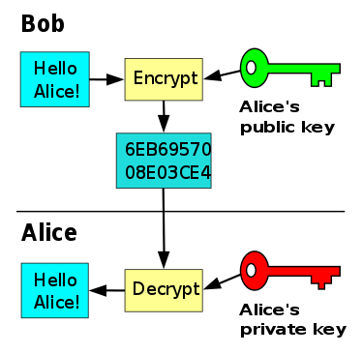
Asymmetrical Keys
Public Keys:
Can be safely distributed
Are used to send messages
Private Keys:
Are not distributed
Are used to decrypt messages

Slide 5
RSA (Rivest–Shamir–Adleman)
One of the first created Crypto Public Key systems
Used by almost all browsers for secured communication in https
Created using two large Prime Numbers that must be kept secret
RSA drawback is that it is a slow algorithm, with limited space in payload
Example of a formatted exported key:
-----BEGIN PUBLIC KEY-----
MIGfMA0GCSqGSIb3DQEBAQUAA4GNADCBiQKBgQDOmTIEK44Ad6O6w+AGfATP5Go5
6zY35tdO8eakvK1I980NoarKraIfC1l6yglLIW6xSijp0Ld0EFFgGLVMB/+MNIHZ
/7JNi3amAUVBPJ7L3F8Fl41w3j8IJ58wYqSeaOMAGsgGrcOc0Lzl3k/pEBThhor9
tmnzl328yOEvLDIGiwIDAQAB
-----END PUBLIC KEY-----
Notes:
Created in 1976, RSA stand for Rivest–Shamir–Adleman, the creators of the algo, this is one of the most commonly used private Key exchanges used in the world.

Slide 6
Public-Key Cryptography Standards (PKCS)
Public-Key Cryptography Standards (PKCS) is a standard that Public keys follow for standardization of implementations of RSA Laboratory Encryptions, including RSA
Messages standards RSA are in PKCS #1 Standard
Two types of Schema encoding of Encrypted Messages
Optimal Asymmetric Encryption Padding (OAEP)
PKCS1-v1.5

Slide 7
package main
import (
"crypto/rand"
"crypto/rsa"
"crypto/sha256"
"fmt")
func main() {
privateKey, err := rsa.GenerateKey(rand.Reader, 1024)
if err != nil {
fmt.Printf("%s", err)
return
}
label := []byte(“secret")
ciphertext, err := rsa.EncryptOAEP(sha256.New(),
rand.Reader, &privateKey.PublicKey,
[]byte("I like cows more than gophers"), label)
if err != nil {
fmt.Printf("%s", err) return
}
plaintext, err := rsa.DecryptOAEP(sha256.New(), rand.Reader,
privateKey,
ciphertext,
label)
if err != nil {
fmt.Printf("%s", err) return
}
fmt.Printf("%s", plaintext)
return
}
Hello World: Asymmetrical Keys with RSA
RSA.Generate() creates a private key and public key
Rsa.EncryptOEAP() encrypts a message key using a: Hash Type (sha256), random data, a Public Key, and a label.
crypto/rand lib is the recommended source of randomized data so your message doesn’t encrypt the same way twice
Rsa.DecryptOEAP() decrypts a message key using the same as encrypt but with the private key
Notes:
Encryption and decryption of a given message must use the same hash function and sha256.New() is a reasonable choice.
The random parameter is for encrypting the same message twice doesn't result in the same ciphertext.
The label parameter may contain arbitrary data that will not be encrypted, but which gives important context to the message.
For example, if a given public key is used to decrypt two types of messages then distinct label values could be used to ensure that a ciphertext for one purpose cannot be used for another by an attacker. If not required it can be empty.

Slide 8
Real life example, Session Key
Session Key is a small symmetric key that is passed between applications to decrypt data
RSA can only encrypt x amount of data, so passing a session keys is ideal
RSA (and most other Public Key encryption) sendable size is calculated by:
Size of Key and/or encoding Hash
Public-Key Cryptography Standards (PKCS) used for encoding the data

Slide 9
Generating Key and Exporting it’s Public
Importing Private Key and Encoding Session Key
//Generate your private key
privateKey, _ := rsa.GenerateKey(rand.Reader, 1024)
//Writing public key into PKCS format
pub, _ := x509.MarshalPKIXPublicKey(&privateKey.PublicKey)
pe := &pem.Block{
Type: "PUBLIC KEY",
Bytes: pub,
}
file, _:= os.Create("../key")
//Encodes Key as a Key file type
pem.Encode(file, pe)
//Creates a server endpoint and waits for a post data from the next script
//runs after first scrtpt, grabs key
respByte, _ := ioutil.ReadFile("../key")
//Decodes key as a pem file type
block, _ := pem.Decode([]byte(respByte))
rsaPublicKey, _ := x509.ParsePKIXPublicKey(block.Bytes)
hash := sha256.New()
hash.Size()
//OEAP Session Key cannot be > keyByteSize - (hashSize *2) - 2
sessionKey := make([]byte, (rsaPublicKey.(*rsa.PublicKey).Size()-(hash.Size()*2)-3))
//populates Session with random data
rand.Read(sessionKey)
}
//adds in random data into the byte string
rand.Read(sessionKey)
fmt.Printf("%v \n", []rune(string(plaintext)))
ciphertext, _ := rsa.EncryptOAEP(sha256.New(),
rand.Reader,
rsaPublicKey.(*rsa.PublicKey),
sessionKey,
label)
//send cipher text back to original script
Decrypting the Session Key
plaintext, _ := rsa.DecryptOAEP(sha256.New(),
rand.Reader,
privateKey,
[]byte(ciphertext),
label)
fmt.Printf("%v \n", []rune(string(plaintext)))

Slide 10
Gotchas when sending Session Key
Using OEAP standard instead of PKCS1v15 is recommended due to new advances in exploits
If you must use PKCS1, use at least a 16-byte key and Decrypt only with DecryptPKCS1v15SessionKey()
Key was passed by just writing it to a common file that both applications had access too
If we didn’t pass the key on the server, but through another means, how safe would it truly be?

Slide 11
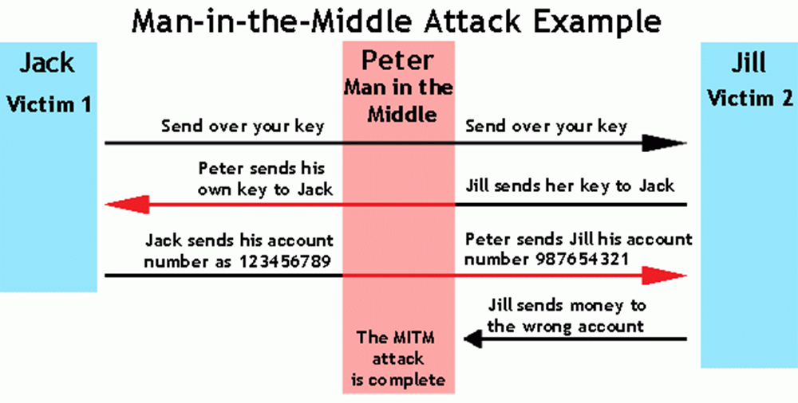
Man in the Middle Attack
This is when an attacker intercepts communications between two parties
If a Public Key is compromised:
The attacker intercepts a key
Spoofs the Key and passes it on
Is now able to read data passed
More importantly can now alter the data being passed
Your Public Key is now useless at keeping your data confidential
Notes:
Need a picture

Slide 12
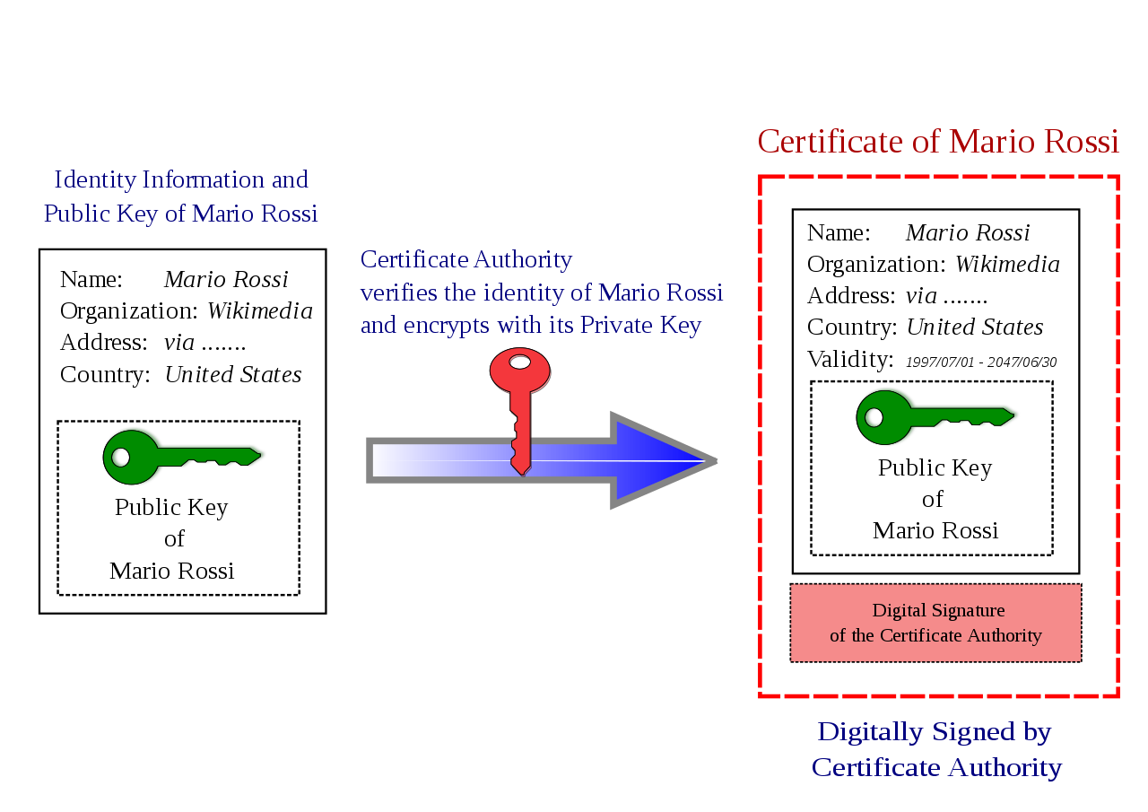
Certificate Authority
Certifies the ownership of Public Key to both an organization and a private key by a digital certificate
Blocks man in the middle attacks by acting as a trusted third party
Encapsulates Public Keys in the x.509 standard
Part of Public Key Infrastructure
Notes:
Trusted Third Party for both creator of key and user of the key
trusted third party (TTP) is an entity which facilitates interactions between two parties who both trust the third party; the Third Party reviews all critical transaction communications between the parties, based on the ease of creating fraudulent digital content.

Slide 13
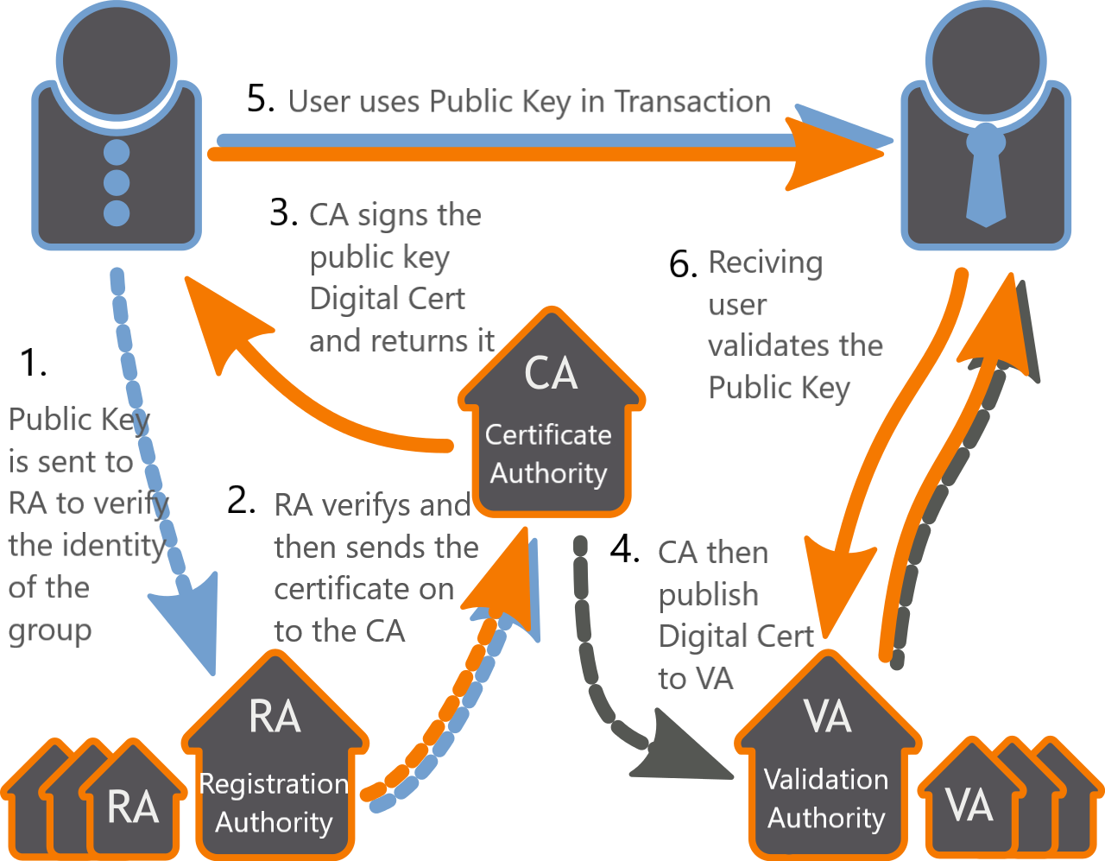
Public Key infrastructure (Pki)
PKI sets policies that allow
Registration of an identity (RA)
To Bind public keys with an identity through a certificate authority (CA)
To vouch for that identity through validation Authority (VA)
Allows reliable verification of an Public Key on an insecure Network

Slide 14
Real Life Use: Passing Certs in TLS
TLS protocol for communicating securely over the internet
Can be used to secure almost all types of web traffic
Hybrid encryption
Uses both symmetric and asymmetric keys
TLS uses Asymmetric keys to authenticate
Symmetric Keys are then used to communicate

Slide 15
Journalism and Anonymous Sources
Sources for Journalist (and therefore the Journalist themselves) have a problem:
Source has some form of data that they feel needs to be released to the public is some way, however, usually there are consequences for this including:
Loss of Job if in the public sector
Government Employees and Military can risk Jail Time
Overseas, in more authoritarian countries regular citizens can risk jail time or worse
This chilling effect can discourage and even prevent people from sharing important information that the public should know
Notes:
Loss of Job in public sector example:
Govement Employees: Daniel Ellsberg, with the Pentagon Papers which exposed the lies of the Government about the Vietnam War
Ended up in front of a Jury Charge with Espinoge and another whole list of charges
Brandon/ Chelsea Manning, for releasing Military Documents about milary lies about Iraq war death tolls and abuse of prisoners and Milatry subtractor that was traffic children
She was tried, convicted and served time in a military prisone for it.
.^{[46]} Amnesty International notes that China "has the largest recorded number of imprisoned journalists and cyber-dissidents in the world"

Slide 16
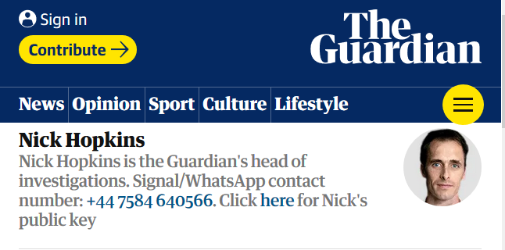
Journalist, especially in the last 20 years have had to adapt to the changing landscape
Two main ways involving Public Key Cryptography are:
Encrypted Emails
Encrypted Chat Apps
Journalist can try to shield their sources however:
Jobs can monitor modes of communications and data access and use that to identify a leaker
Governments can:
Intercept data being sent with Subpoena
Subpoena for data even after transmission from carriers
Some carriers with government approval will shut down encrypted connections

Slide 17
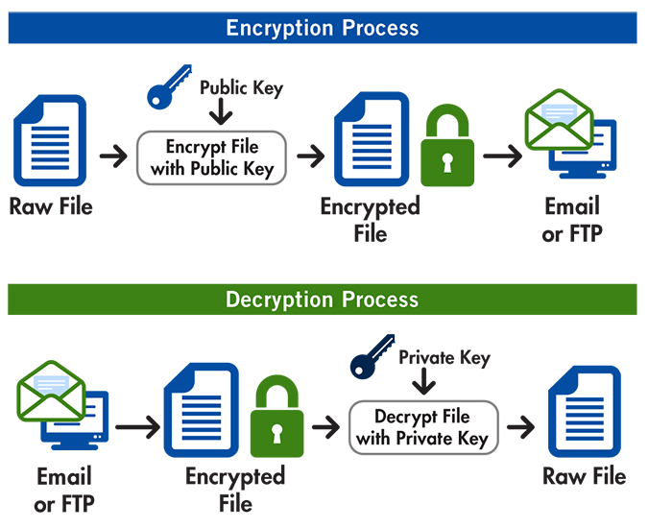
PGP (PRETTY Good Privacy)
A Protocol used for encrypting files, text and email, which usually isn’t secured, which allows it to have the same security as a browser.
Uses Public Keys along with several other elements for the protocol:
Digital Signature to verify data integrity
Circle of trust to attest to the identity of the owner
Able to use a wide variety of Public Key including RSA

Slide 18
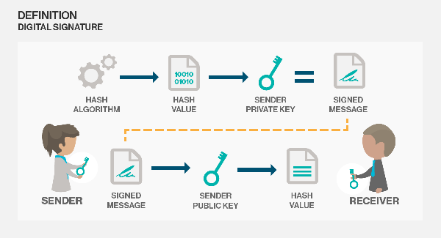
Digital Signatures
Is a way for Asymmetric Key encryption to validate a message authenticity from a sender
Sender Hashes then Encrypt a new signature with there private key
Receiver:
Decrypts the file
Hashes the Decrypted File
Decrypt the sent signature
Compares the two hash to determine if the file was sent by who it was claimed
Notes:
Like checking a math problem

Slide 19
Circle of Trust
Phil Zimmermann, creator of PGP, explains circle of trust: As time goes on, you will accumulate keys from other people that you may want to designate as trusted introducers. Everyone else will each choose their own trusted introducers. And everyone will gradually accumulate and distribute with their key a collection of certifying signatures from other people, with the expectation that anyone receiving it will trust at least one or two of the signatures. This will cause the emergence of a decentralized fault-tolerant web of confidence for all public keys.
In Contrast of PKI centralized authority, PGP uses a circle of trust policy which allows for a decentralized groups to attest to a Public Key authenticity
Any user can be an part or link to the circle of trust through their identity certificate
Notes:
This allows for Journalist to have a decentizlied groups for handling different parts of the investigation

Slide 20
PGP libraries
entity, err := pgp.GetEntity([]byte(TestPublicKey), []byte(TestPrivateKey))
if err != nil {
t.Error(err)
}
fmt.Println("Created private key entity.")
signature, err := pgp.Sign(entity, []byte(TestMessage))
if err != nil {
t.Error(err)
}
fmt.Println("Created signature of test message with private key entity.")
publicKeyEntity, err := pgp.GetEntity([]byte(TestPublicKey), []byte{})
if err != nil {
t.Error(err)
}
fmt.Println("Created public key entity.")
err = pgp.Verify(publicKeyEntity, []byte(TestMessage), signature)
if err != nil {
t.Error(err)
}
fmt.Println("Signature verified using public key entity.")
Basic implementation of a PGP library in a importable library is github.com/jchavannes/go-pgp
Allows for decrypting and encrypting messages
Allows for signing digital signature verification
Importing of PGP Keys
Dead Easy

Slide 21
Official GO PGP Implementation
Official PGP implementation is in golang.org/x/crypto/openpgp
It’s expansive and complex
Main Package: Contains main function for encrypting and decrypting with PGP
github.com/jchavannes/go-pgp code has basic usage of this package
Packet: implements parsing and serialization of PGP
Can import RSA and other key types here to be used in PGP
Configuration for Main package is here, along with what the standard configuration is
Clearsign: can be used in PGP for sending small messages instead of files

Slide 22
When PGP Fails
Journalist and sources with PGP have a secure communication line, but the endpoints are not
What happens when:
Private key is leaked/stolen
Either party computer is stolen/compromised
Government issues warrant for computer/phone/etc
You now have the ability to prove the communication between to parties and what data was passed
This is considered admissible evidence in most courts of law

Slide 23
Off The Record Messaging
Sends time sensitive message that expire
Once message expires, almost impossible to decrypt it again
Identity of Participants are confirmable at Delivery, but not afterward nor to external Users
Allows for deniability of message intergrity of due to malleable encryption
Uses Diffe-hellman Key Exchange, a Public Key Implementation of Diffe-Hellman, that passes a symmetrical key
Signal Protocol is based off this, which is used by Facebook Whats up app and many other secure chat apps
Notes:
Be Patient with this
First going to give a summary of the parts of Off the Record Message Protocol
Then Go into Diffe Hellman
And the swing back to explain OTR in context of Diffe Helman

Slide 24
Diffe-HellMan Key Agreement
Diffe-Hellman allows two parties who haven’t communicated before to establish a shared Key over a public network.
A User isn’t sharing information during the key exchange, they’re creating a Public key together
Nobody analyzing the traffic at a later date can break in because the key was never saved, never transmitted, and never made visible anywhere.
Notes:
https://security.stackexchange.com/questions/45963/diffie-hellman-key-exchange-in-plain-English
http://library.open.oregonstate.edu/cryptography/chapter/chapter-14-diffie-hellman-key-agreement/

Slide 25
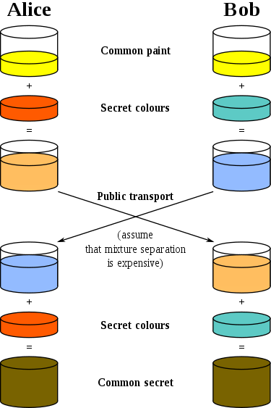
From Wikipedia Diffe-Hellman:
The process begins by having the two parties, agree on an arbitrary starting color that does not need to be kept secret but should be different every time; in this example, the color is yellow.
Each of them selects a secret color that they keep to themselves – in this case, red and blue-green. The crucial part of the process is that each user mixes their own secret color together with their mutually shared color, resulting in orange-tan and light-blue mixtures respectively, and then publicly exchange the two mixed colors.
Finally, each of the two mixes the color they received from the partner with their own private color. The result is a final color mixture (yellow-brown in this case) that is identical to the partner's final color mixture.
Notes:
If a third party listened to the exchange, it would only know the common color (yellow) and the first mixed colors (orange-tan and light-blue), but it would be computationally difficult for this party to determine the final secret color (yellow-brown). In fact, when using large numbers rather than colors, this action is computationally expensive: It is impossible to do in a reasonable amount of time even for modern supercomputers.

Slide 26
Perfect forward secrecy
New public key is negotiated
Message is encrypted with a symmetrical key
Symmetrical key is encrypted with new public key
All data is sent to other person
Symmetrical key is decrypted
Message is decrypted
All Keys are destroyed
Rinse and repeat
Order of operations
One of the four pillars of Off the Records Encryption
Enabled by Diffe-Hellman Key Exchange ability to negotiate new keys allows it continuously create keys
Since able to negotiate a new key every call gives the ability for old keys expire
Once message expires, almost impossible to decrypt it again
This allows for Users access messages when sent but once the key is discarded, the message cannot be decrypted again

Slide 27
Other Pieces of OFF the REcord
Malleable Encryption
Want to make it easy to prove that someone could have altered the message
Uses a encryption that makes it easy to alter the data even without having the key, but if is altered turns the text into garbled nonsense
Allows for culpable deniability
Digital Signature
Since a signature can be legally tied back to a person, it is not used to ensure a message author
Message Authentication Codes (MAC)
Used to confirm that message was sent by the intended user, however only at the time of receiving it
Hash on the message using a symmetric key that was passed before, that is then passed with the message for comparison
Doesn’t prove to other that the user sent the message because it can only prove that someone with the Mac Key generated it

Slide 28
OTR implementations iN GO
No implementation of just OTR in Golang as of Today
Signal Protocol, which is based of OTR implementation exists:
https://github.com/dosco/libsignal-protocol-go
Implemented most of the OTR
Has not implement Perfect forwarding secrecy yet
The parts of OTR are making there way in:
Diff-Hellman Key Exchange is just making into PR form into Golang SSH:
https://github.com/golang/crypto/pull/87/commits/2670271971c9efab8513c349be0c483e1ad225c1
Maluable Encryptions are already including in Golang with AES encryption

Slide 29

Thank you so much For Coming
Thanks to:
Samsara for being Great Host
Women Who Go for this opportunity
Joey, my Husband
My Coworkers at Pursuant Health
And You for Making it all the way through!

